Slide 1




Python
Crash Course

Slide 2
Introduction

Slide 3
About Python
One of the fastest growing language in terms of
Number of developers using it,
Number of libraries it has
Number of companies
Areas where it has been implemented (ML, GUI, Software Development, Web Development, IoT)
Python was created in 1987. (Java was created in 1995)
Mostly used by scientists, researchers and engineers. They need a simple language to learn and get their work done
Python is much simple that C, C++, C#, Java, etc. This is why it is thought in schools.
Python was developed by Guido Van Rossum and it what named after his favourite movie.
It was create for those that do not like to code but need code to get work done.

Slide 4
IDLE

Slide 5
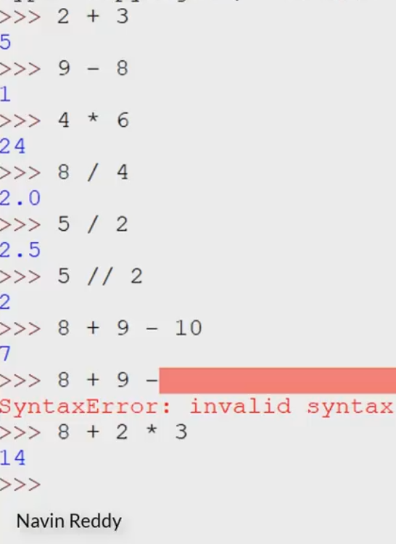
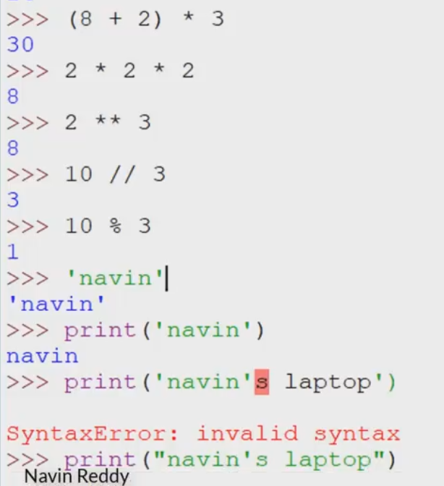
Integrated Development and Learning Environment - IDLE
Addition
Subtraction
Multiplication
Division
Modulus
Bracket
Exponential/Power
String

Slide 6
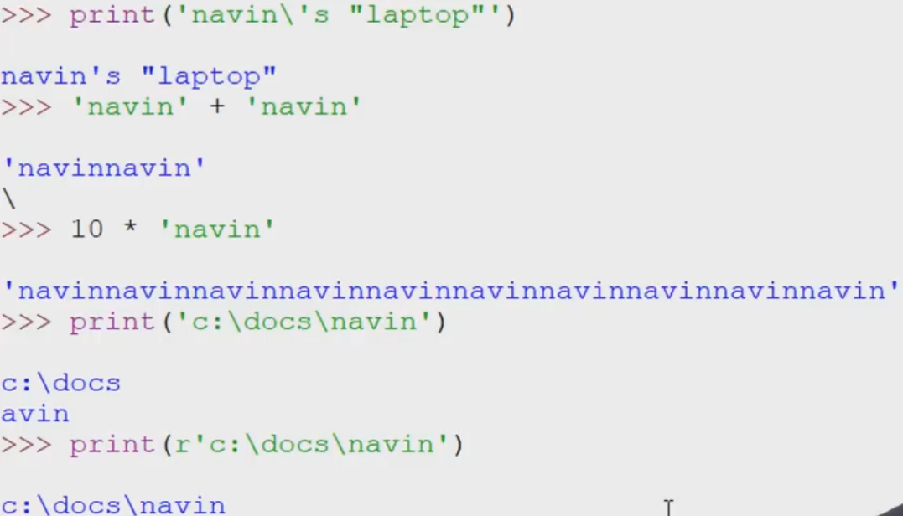
Integrated Development and Learning Environment - IDLE
Escape Sequence
Repetition
Raw string

Slide 7
Variables

Slide 8
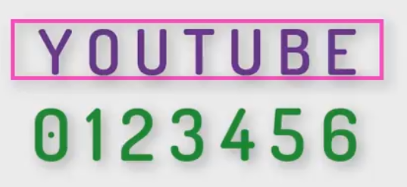
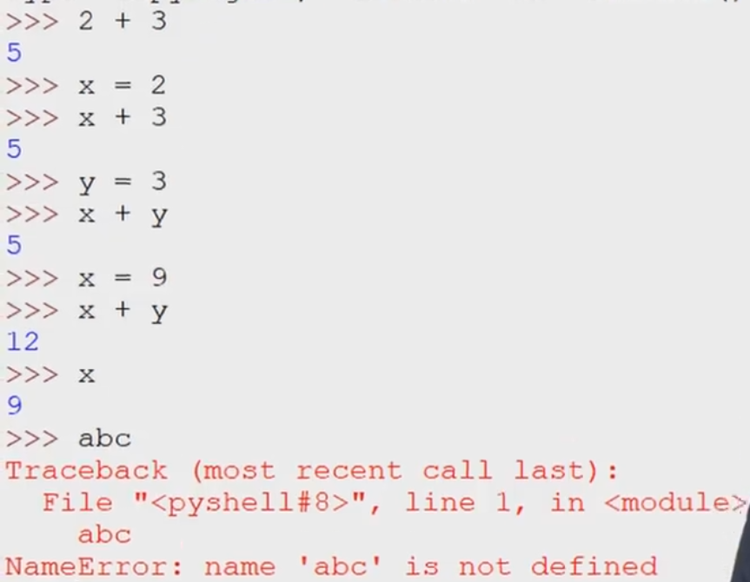
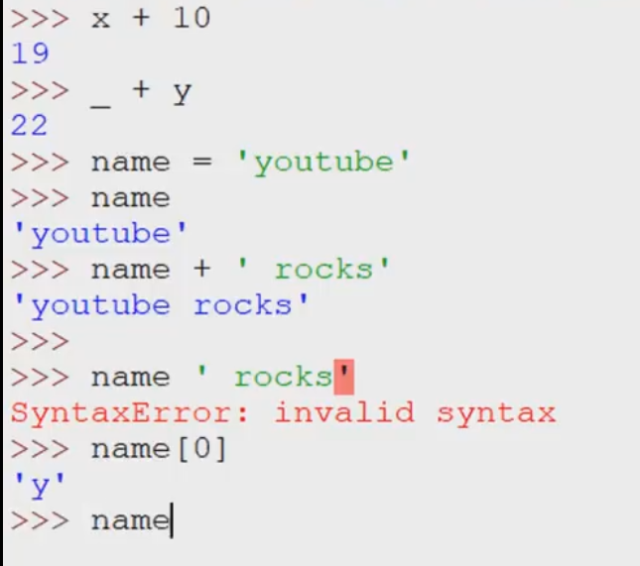
Working with Variables
Adding 2 variables

Slide 9
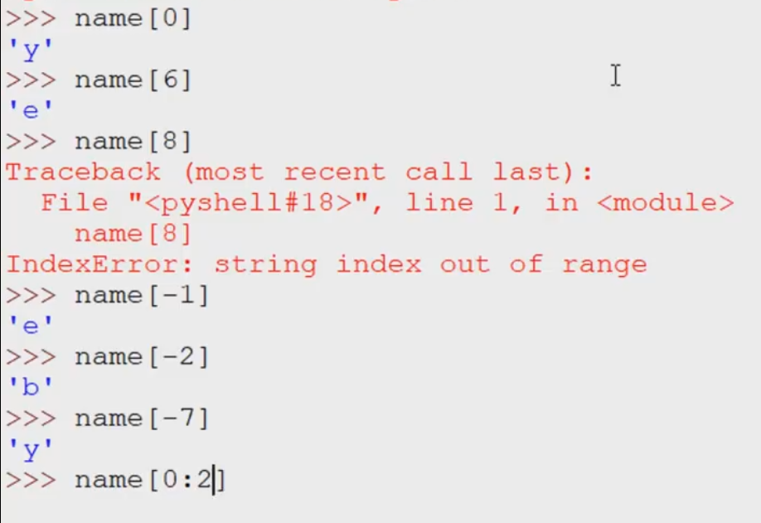
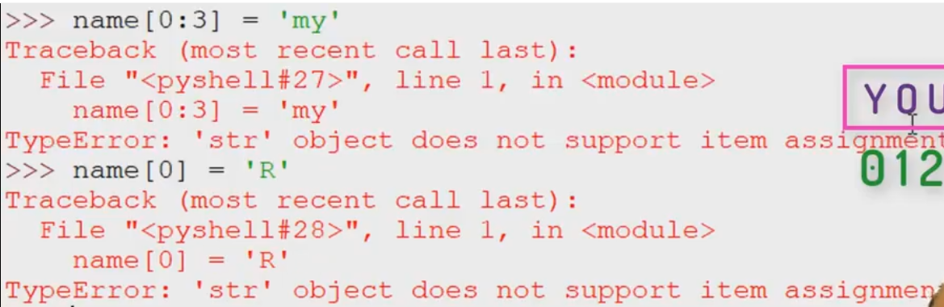
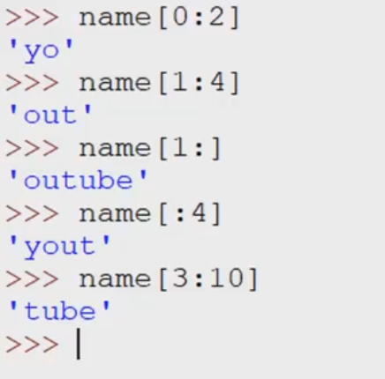
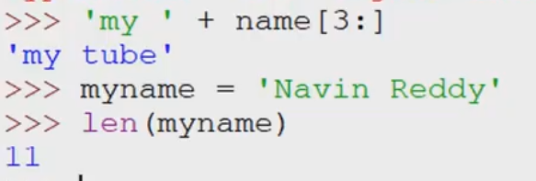
Working with List Variables
Index
Extraction
You cannot change strings
In Python, strings are immutable.
Counting strings

Slide 10
Lists

Slide 11
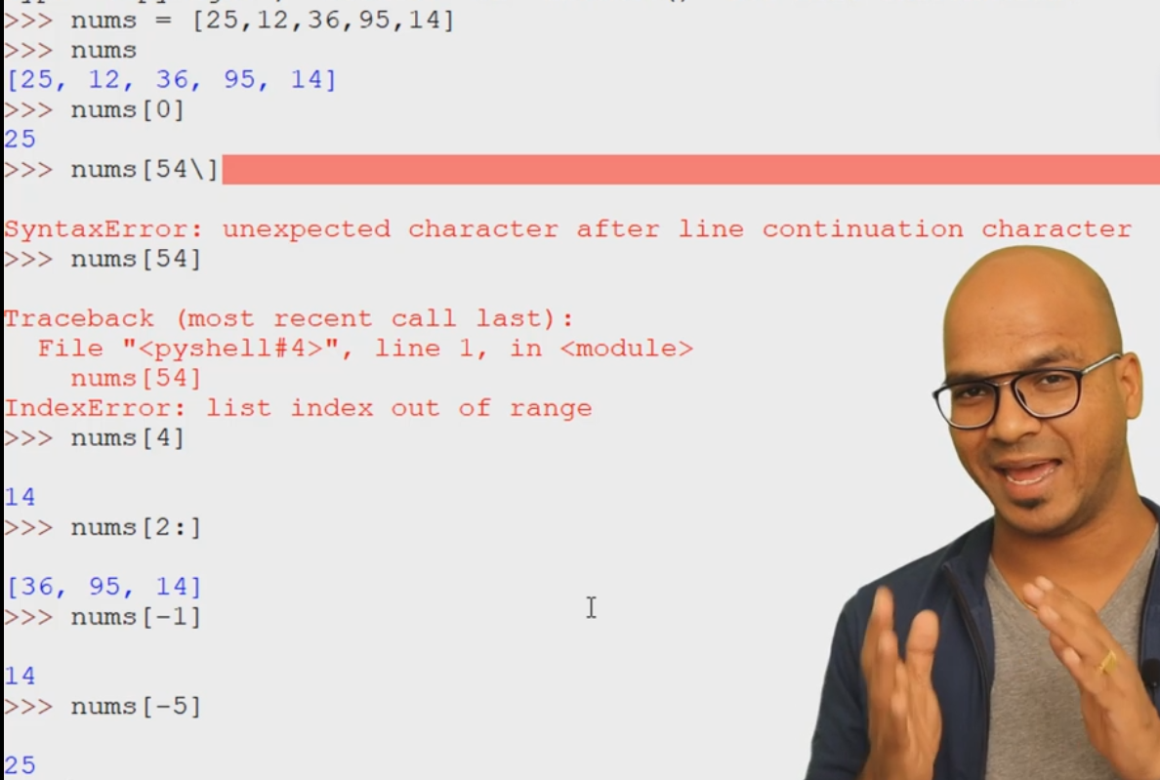
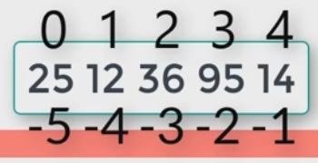
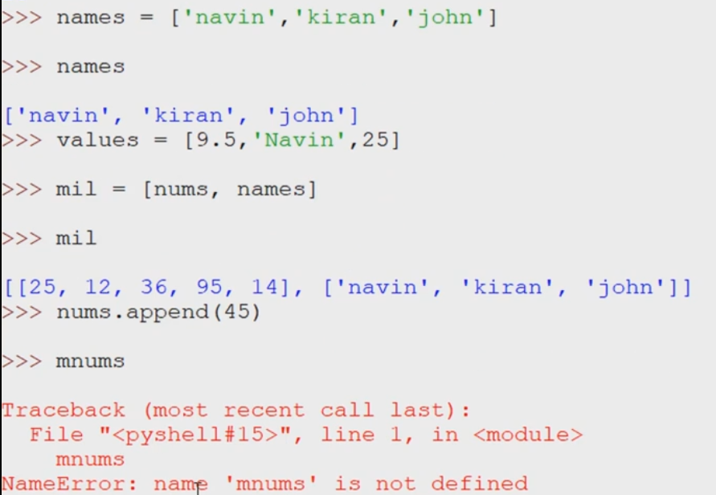
Working with Lists

Slide 12
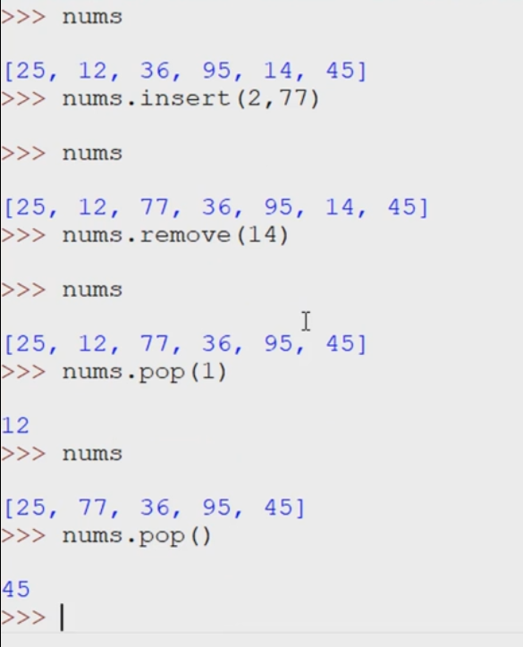
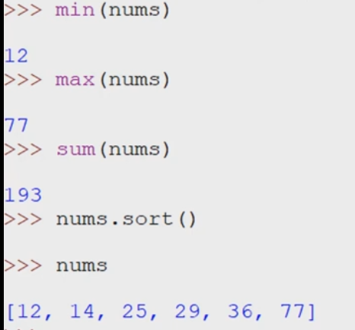
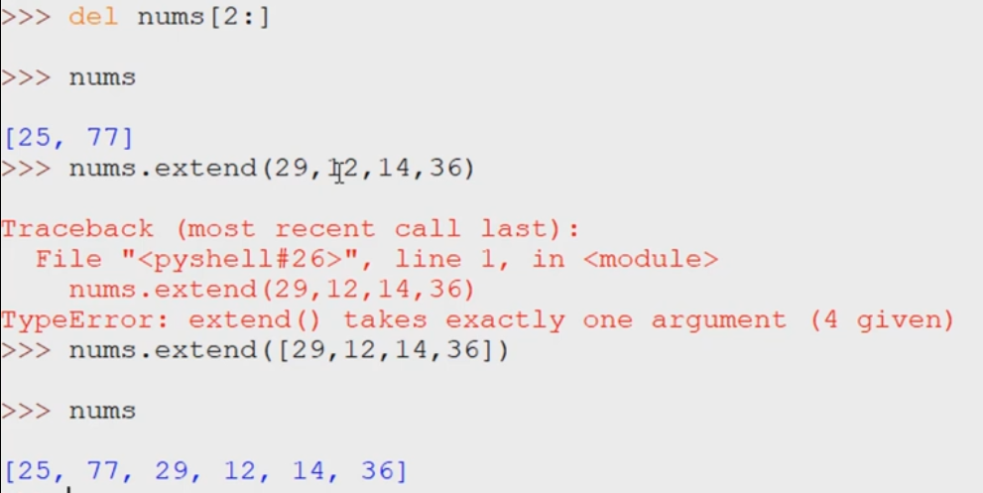
Working with Lists
Insert
Remove Item
Pop removes the last item added to the list
Built in
Functions
Add multiple items to a List

Slide 13
Data Types

Slide 14
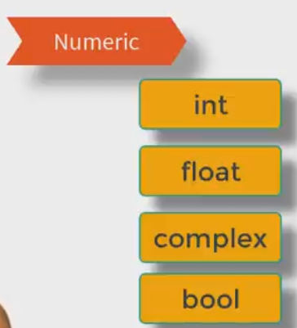
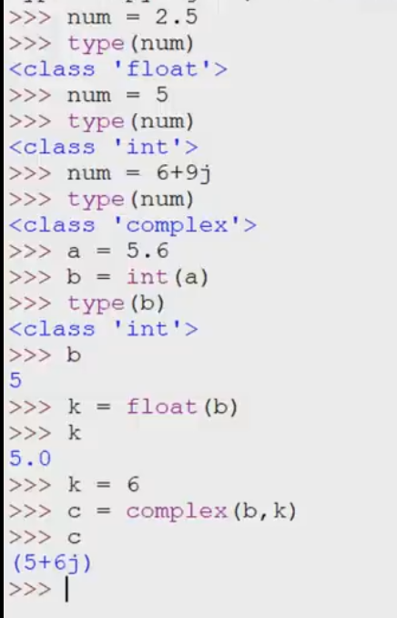
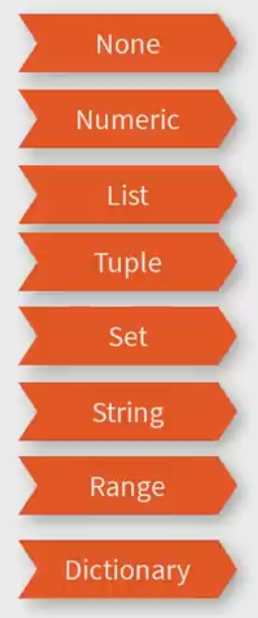
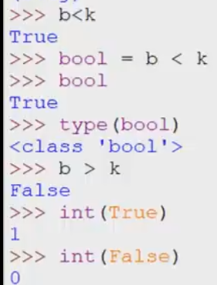
Data Type - Numeric
We a variable is not assigned a value

Slide 15
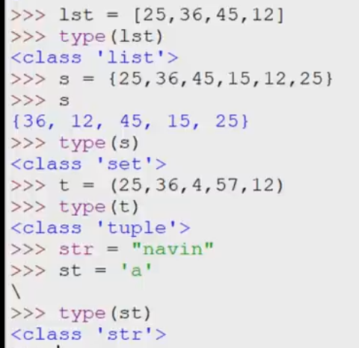
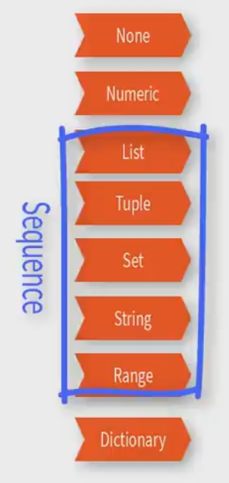
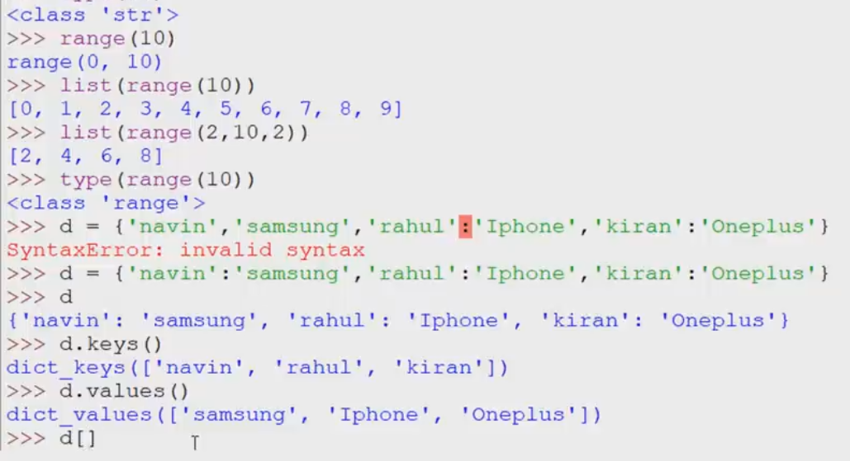
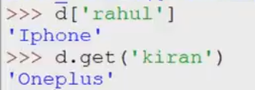
Data Type
Sequence

Slide 16
Operators

Slide 17
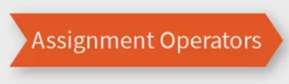
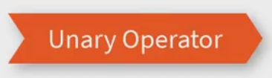
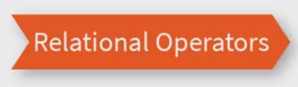
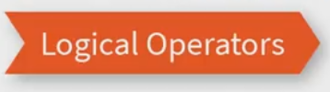
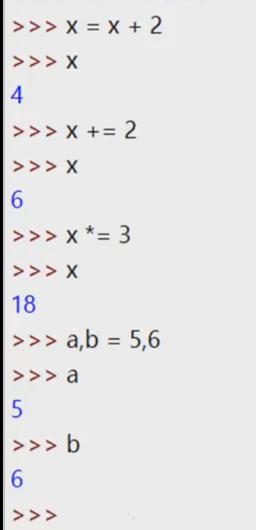
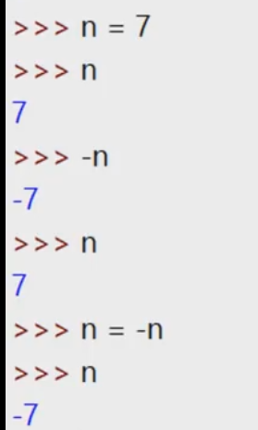
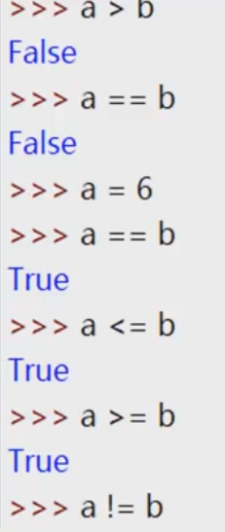
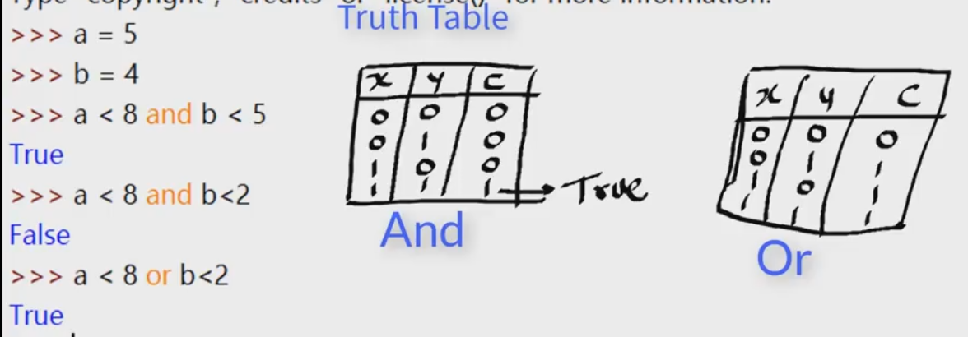
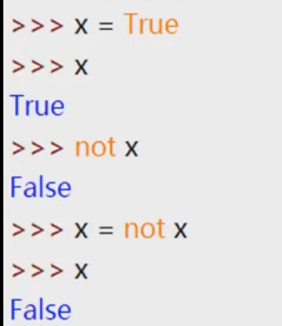
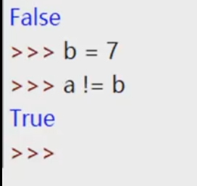
Operators

Slide 18
Import Maths Functions

Slide 19
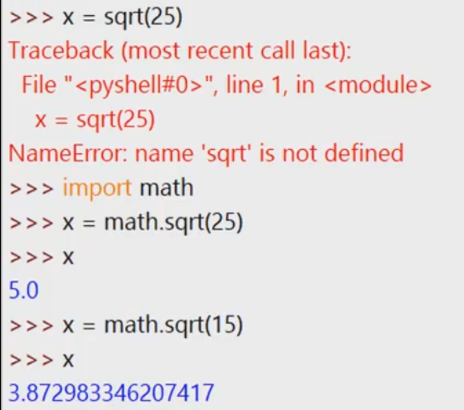
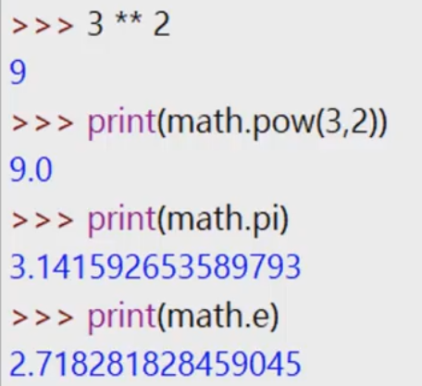
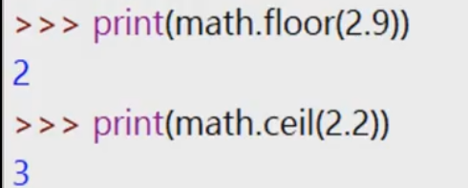
Maths Functions
Square Root
Power Function
Pi
Epsilon
Floor and ceil

Slide 20
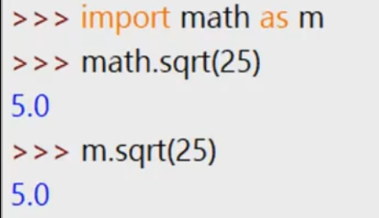
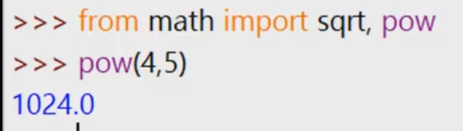
More on Import
Alias
Pi
Epsilon
Importing selected functions

Slide 21
User Inputs

Slide 22
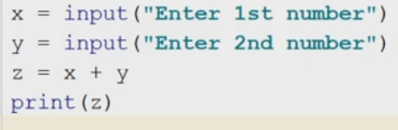
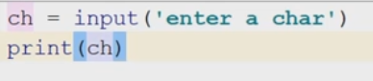
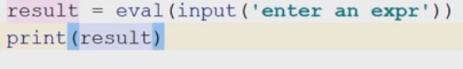
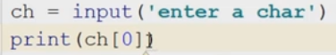
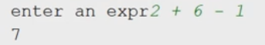
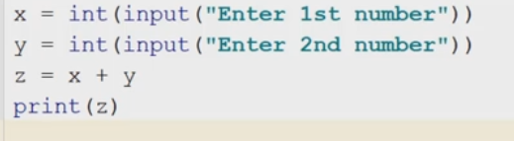
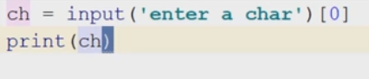
Capturing User Inputs
Capturing a character from the keyboard
Evaluating an expression
User input
Casting into the right data type

Slide 23
If Elif Else Function

Slide 24
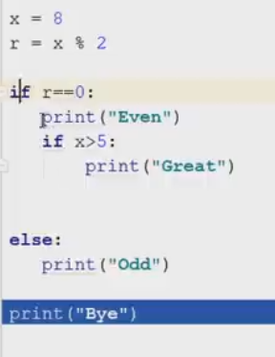
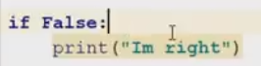
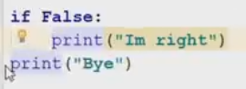
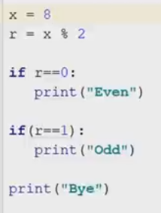



Working with conditional Statements
If Block or Suite
Nested Ifs
Indentation
Using Elif

Slide 25
While Loop

Slide 26



While Loop
Print this 5 times
Print this 5 times with While loop

Slide 27
For Loop

Slide 28










For Loop
Print this list
Print each item in the string
Print each item in the list
Print each item in the list

Slide 29
ASSIGNMENT
Create a Business Model Canvas for SkillCanvas.

Slide 30


Contact Us
Address
CAD Consulting Limited
30, Trans-Woji Road
By Slaughter Bridge.
Contact Info
Email: Ibinaiye.wale@cadconsultingltd.com
Telephone
Funded by CBN
Office Phone: 08033131904, 08099866659

